Slide 1
Scouting System for NBA Players

Slide 2
1-Introduction
In today’s world as every profession tends to become more professional and efficient, the world of sports has become a major financial giant with these innovations. As this expansion continues, the margin of error has been narrowed for both athletes and teams. Desire of excellence has pushed these athletes and teams to find ways to evaluate performances of individuals and gain a general understanding of their performance. As for the basketball, this quest for individual analysis had started when NBA introduced us with the “box score”, where officials kept every player’s point, rebound assist etc. to evaluate each player’s performance after a match just by looking at stat sheet. For quite some time, this method was enough for the coaches, team managements and fans but as the industry grew and become more competitive over the years, these metrics weren’t satisfying anyone. So, stat analysts came with the idea of advanced metrics and data analytics. These innovations helped team managements and coaches to work more efficiently and bring their team success.
This project aims in a similar way, enhancing the analysis of NBA players by introducing a customized metric, Customized Efficiency Rating (CER), aiming to reflect more accurate results than the traditional statistics. The primary object of this project is to classify NBA players who were selected as All-Star players throughout 2019 to 2024 into three performance categories: MVP caliber, All-NBA Caliber and All-Star Caliber. This classification helps us to distinguish players who are top performers, solid contributor, and standout talents within all of the All-Star selections.
By using the machine learning techniques and a dataset consist of All-Star players of 2019-2024, this project seeks to create a data-driven approach to predict player efficiency. With classification, not only helps us to have a better player assessment but also helps enhancing decision making processes related to scouting and contract negotiations procedure.
In this report, I’ll be showing the processes of creating a dataset, developing the efficiency metric, implementing machine learning models and experimental results.

Slide 3
2-Dataset Description
This project’s dataset consists of detailed performance statistics of NBA players selected as All-Stars throughout 2019 to 2024 seasons. Dataset consists of 60 players, reflecting a niche quantity of players that quantify each player’s contributions throughout the season. Dataset features the following columns:
player_name: Name of the player
conference: The conference in which the player competes, either East or West.
games_played: Amount of game a player played during the season.
mp (minutes per game): Average minutes played per game.
ppg (points per game): Average points scored per game.
rpg (rebounds per game): Average no. of rebounds per game.
apg (assists per game): Average no. of assists per game.
spg (steals per game): Average no. of steals per game.
bpg (block per game): Average no. of block per game.
to (turnovers per game): Average no. of turnovers per game.
fg% (field goal percentage): Percentage of field goal attempts that are successful.
3p% (three-point percentage): Percentage of three-point shot attempts that are successful.
2p% (two-point percentage): Percentage of two-point shot attempts that are successful.
ft% (free throw percentage): Percentage of free throw attempts that are successful.
Salary: the player’s salary for the season in USD
Each feature in this dataset corresponds to an individual player’s statistics on a particular side of the basketball game, gives us an opportunity to analyze the players in a more dimensional way. This dataset was preprocessed to ensure there are no missing values in any of the columns The statistics provided are used to calculate the Customized Efficiency Rating (CER), which helps us on basis for subsequent analysis and classification into performance categories: MVP Caliber, All-NBA Caliber, and All-Star Caliber.

Slide 4

3-Methods
Data Preparation:
As we see on the previous part, every entry has 14 features that need to be filled by every entry, so in order to get a better understanding of the dataset that I have and also make sure every entry has a variable and suits its data type, I used the methods below:

Slide 5
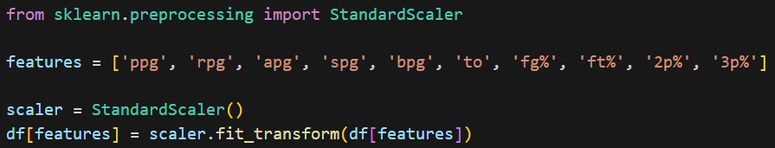
Data Normalization:
StandardScaler from sklearn.preprocessing was utilized to normalize features like ppg, rpg, apg, spg etc. to ensure all variable contribute equally.

Slide 6
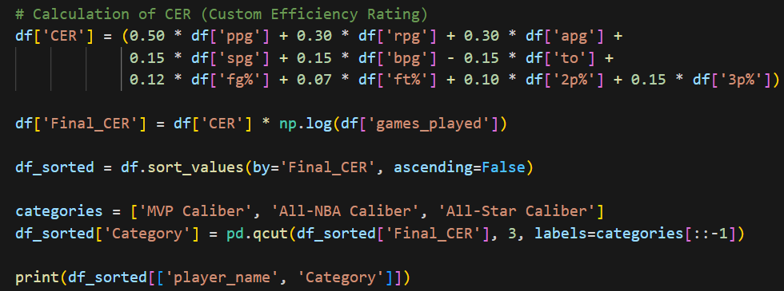
Feature Engineering:
For this project, I have created a customized rating system which is called Customized Efficiency Rating (CER) to calculate each player’s efficiency score based on weighted contributions from all recorded statistics. The CER also takes number of played games into account to factor in consistency and durability over the season. Based on their CER score, players are categorized into three performance categories: MVP Caliber, All-NBA Caliber, All-Star Caliber. CER was inspired by the real-life rating system Player Efficiency Rating (PER).

Slide 7
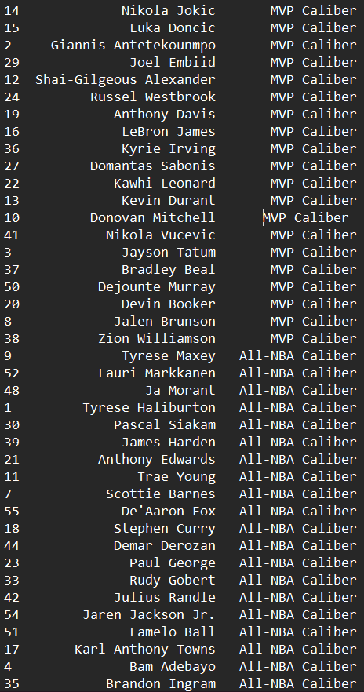
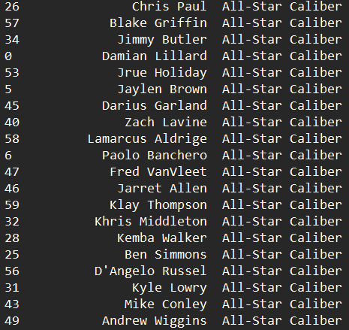
Results:

Slide 8

Feature Engineering:
Furthermore, to enhance more powerful models, several new features were found. A new variable created to capture interactions between different metrics, such as the product of point per game (ppg) and field goal percentage (fg%). In addition, polynomial transformation of “ppg” and “apg” were implemented to include non-linear relationship in the models. These new features help us look from another direction on the offensive metrics of the statistics.

Slide 9
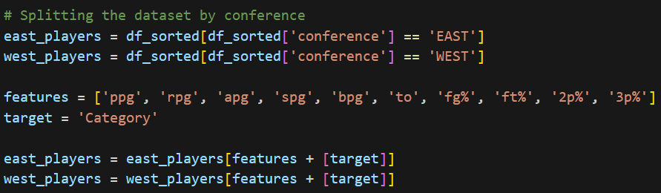
Training and Testing:
For the training and testing part, the dataset was split into two training sets: east players and west players to ensure that models are generalizable. Also a training model for the whole dataset has constructed.

Slide 10
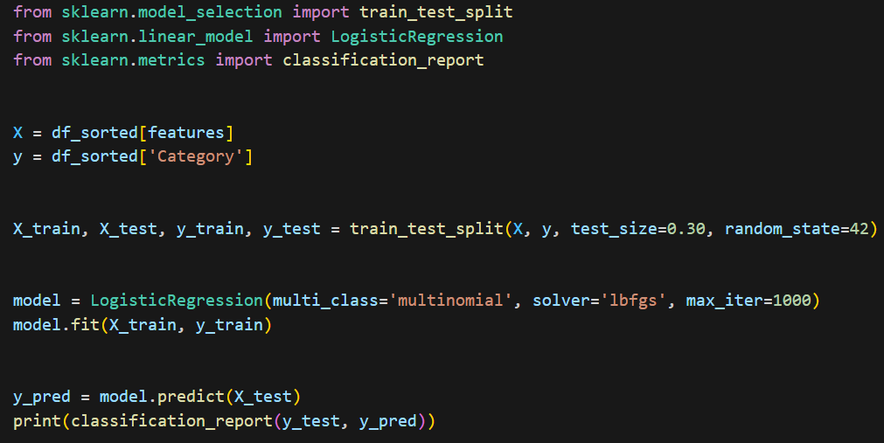


Training and Testing:
train_test_split: This function is used to split the dataset into training and testing subsets. The parameter test_size=0.3 specifies that 30% of the data will be used for testing while the rest is used for training.
LogisticRegression: Logistic regression is a data analysis technique that uses mathematics to find the relationships between two data factors. It then uses this relationship to predict the value of one of those factors based on the other.model.fit(X_train, y_train): It trains the model using the training data.
y_pred = model.predict(X_test): It makes predictions using the test data.
classification_report(y_test, y_pred): This report evaluates the classification performance of the model. It includes metrics such as accuracy, precision, true positives, and true negatives.
This code splits the data into training and testing subsets, trains a model using Logistic Regression, evaluates this model on the test data, and reports the results using the classification_report. These results are used to measure the model's classification ability.

Slide 11
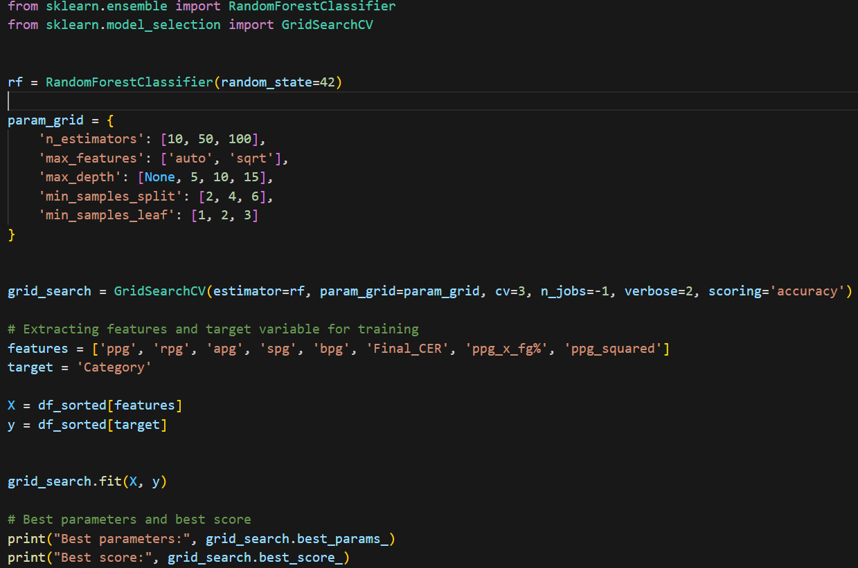
Hyperparameter Tuning
In this project, hyperparameter tuning was conducted by using GridSearchSV to reach the optimal settings for RandomForestClassifier, making sure that various metrics could be performed effectively.

Slide 12
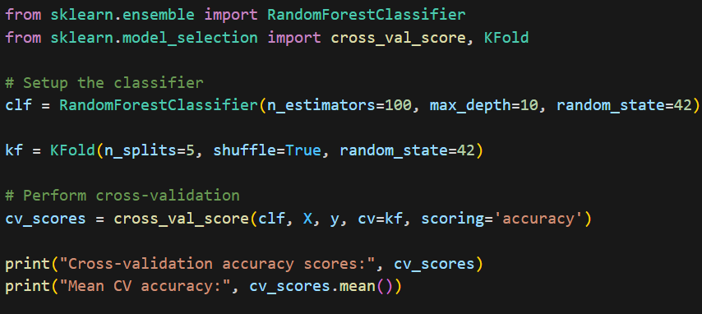
Cross Validations :
K-Fold
This method partitions the data into 5 splits and uses 1 subset for testing and remaining 4 for training. This technique helps to asses the model’s performance across different subsets of dataset, providing information about dataset’s consistency and stability.

Slide 13
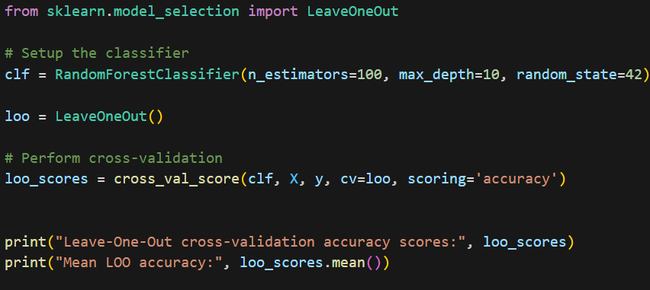
Leave-One-Out Cross Validation
For a more precise validation, Leave-One-Out (LOO) validation was conducted. LOO uses each data point as a single test case and remainder of the dataset as a training set. This method provides a detailed view of the model’s performance on an individual level.

Slide 14
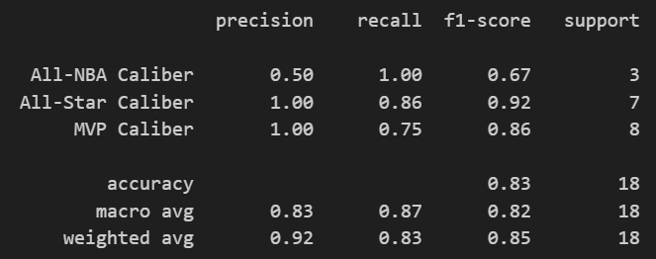
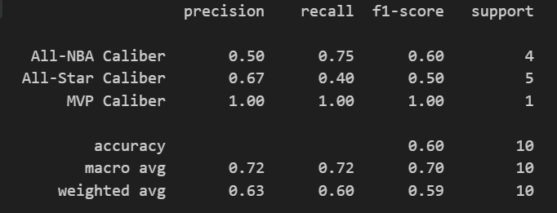
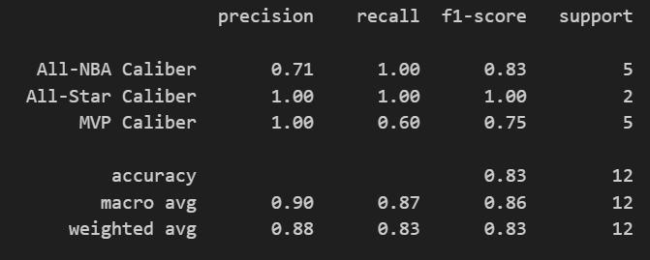
4-Experimental results
All players Test Result East&West players Test Result

Slide 15
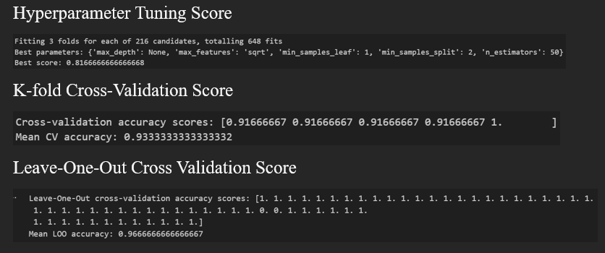

Slide 16
5-Conclusion
Before starting this project, my main goal was to use machine learning to classify NBA players into performance categories based on their seasonal statistics. Along the way to succeed my goals, I’ve learned how to use traditional techniques such as and logistic regression and implement them into my project to gain results. Also, I developed a Customized Efficiency Rating (CER) that effectively identified MVP candidates and differentiated between performance levels. Hyperparameter Tuning helped optimized the models and cross-validation methods showed the model’s robustness and generalizability.
This project helped me understand the potential of machine learning in sports analytics and how far these kinds of algorithms can affect the game of basketball in a positive way.

Slide 17
References:
www.basketball-reference.com
www.hoopshype.com

